Slide 1

My Career
APPLIED PROJECT AND MINOR dissertation
Alexander Souza – G00317835
Supervisor
Damien costello

Slide 2
introduction
My idea is an online system that would help in the process of recruiting and selecting candidates for position.
The System will have a public access page, where the candidates can apply for the job available, and thus initiate the registration of your CV and relevant data.
In the area of system administration, it would provide tools to manage job offers, manage CVs candidates, and manage the recruitment process by recruiters.

Slide 3
objectives
Make notes about the candidates at the time of the interview;
Create Technical Evaluations for candidates, with questions;
Reports;
Candidates will have scores for the position;
Notification of new jobs to those enrolled in the Newsletter;
Possibly Statistical Charts;

Slide 4





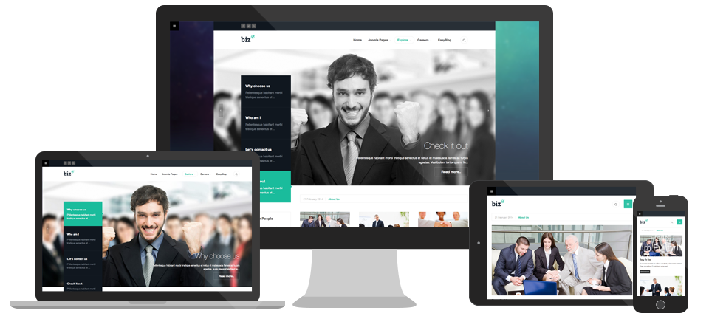









ARCHITECTURE / TECHNOLOGIES
Back end
Front end
cms
RESTful API
Authentication Server - JSON Web Tokens
Authentication Request
Access Token
Career application module will be embedded on website
Request for
Protect Resource
(Access Token)
Protected
Resource
Users
Access Control
System Data

Slide 5
Project plan
Add all references and comments to use in the dissertation.
Agile Approach:
Prototype
Test
Add
Using GitHub for:
Tracking Commits/Branches
Creating Milestones & logging issues

